Slide 1
A20 ARCHITECTURE OPTIONS
 | CURRENT STATE | MICROSOFT ROADMAP ALIGNED | BEST OF BREED ON AZURE
TECHNOLOGY OPTIONS
BUSINESS INTELLIGENCE | PowerBI, SSAS, Tableau, Cognos | PowerBI, SSAS, Tableau, Cognos | PowerBI, SSAS, Tableau, Cognos
DATA PROCESSING | Data Engineering Toolkit on Azure HDInsight | Azure Data Factory | Informatica IPaaS
ADF PLATFORM -- TENANT | Azure HDInsight | Azure Synapse | Snowflake
ADF PLATFORM – REFINE, ENRICH | Azure HDInsight | Azure Clearlake | Snowflake
ADF PLATFORM - RAW | ADLS | ADLS | ADLS
DATA MANAGEMENT | KP Standard – Collibra, Waterline data | Azure Babylon | Informatica Data Management
EVALUATION CRITERIA
USE CASE COVERAGE
COST EFFICIENCIES
EASE OF ADOPTION
OPERATIONAL SUSTAINABILITY

Slide 2
A20 ARCHITECTURE OPTIONS
 | CURRENT STATE | MICROSOFT ROADMAP ALIGNED | BEST OF BREED ON AZURE
TECHNOLOGY OPTIONS
BUSINESS INTELLIGENCE | PowerBI, SSAS, Tableau, Cognos | PowerBI, SSAS, Tableau, Cognos | PowerBI, SSAS, Tableau, Cognos
DATA PROCESSING | Data Engineering Toolkit on Azure HDInsight | Azure Data Factory Databricks (added) | Informatica IPaaS Informatica BDM
ADF PLATFORM -- TENANT | Azure HDInsight | Azure Synapse | Snowflake
ADF PLATFORM – REFINE, ENRICH | Azure HDInsight | Azure Clearlake Databricks Delta | Snowflake
ADF PLATFORM - RAW | ADLS | ADLS | ADLS
DATA MANAGEMENT | KP Standard – Collibra, Waterline data | Azure Babylon | Informatica Data Management
EVALUATION CRITERIA
USE CASE COVERAGE (Analytical, Governance, AI/ML) |  | Databricks can be leveraged for AI/ML use cases Unified Batch and Streaming – Databricks Delta | Additional process required to execute AI/ML use case on Snowflake proprietary
COST EFFICIENCIES (Price - performance) |  | Lower price performance $ per Query per Hour | Storage Cost can be slightly higher against standard Object store cost
EASE OF ADOPTION (Skillset, Development time, Migration) |  | Integrated Development environment (Studio) Continuous Integration & deployment using Azure DevOps | GUI based and SQL Like Interface Accelerator for Schema and Data Migration
OPERATIONAL SUSTAINABILITY (Maintainability, Scalability, Reliability ) |  | Single pane of glass for all services Integration with Azure Monitor and Log Analytics | Multiple Access path Individual Service Management Online Scaling Snowflake
Security |  | Native Row, Column Level & Dynamic Data Mask Security Advanced Threat Protection | Secure View Based Security control No Native Azure Active Directory Integration

Slide 3
A20 – Use Cases
Data Sourcing | Structured and Semi Structured Dataset
 | Real Time, Near Time and Batch Ingestion
Data Zones | Multi-Tier Data Storage to support Multiple business needs (Raw/Refined/Enriched)
 | Data Quality and Enterprise level data conformation
 | User Driven Business Data need (Tenant Zone)
Data Architecture | Scalable and Available Architecture
 | Efficient and Performance Oriented Process
 | Plug and Play Design – Support API, DaaS,

Slide 4
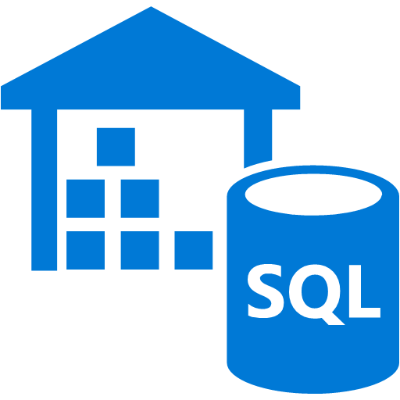
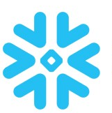

A20 ARCHITECTURE OPTIONS – Technical Highlights
Azure Synapse Analytics
Most comprehensive security built-in
Industry leading price/performance
Intelligent Workload Management (WLM)
Data Lake Integration
Snowflake
Built for the cloud”
Breathtaking Performance
Unlimited Concurrency
Zero-management DWaaS
Dynamic elasticity to mixed and dynamic workloads
Databricks
Databricks Delta, a powerful transactional storage layer that harnesses the power of Apache Spark and Databricks DBFS.
Pools - Fast and isolated job submission using standby pool of instances
Seamless integration with Azure Services - Azure Data Factory & Synapse Analytics
Hive
Not True RDBMS, Not designed for OLTP
Latency of Apache Hive queries is generally very high
Hive and Spark have interoperability challenges

